Slide 1
EVOLVING NEURAL NETWORK SHAPE WITH THE ANT COLONY OPTIMIZATION ALGORITHM FOR PREDICTING EYE STATE WITH EEG DATA
Authors: Ryan Bagby
Lennord Massau
Michael Knapp

Slide 2
Neural network Using Back-propagation
Our design is unique in the ways listed:
Project Design was a neural network
Using Backpropagation
We used an ant colony optimization algorithm

Slide 3
Using the Ant colony optimization
This gave us the ability to find a better shape for the hidden layer of our NN
Our NN was getting accuracy rates of 50 to 60%
After using the ant colony optimization we achieved 88%
With approximately 10 iterations and using only 10 ants.

Slide 4
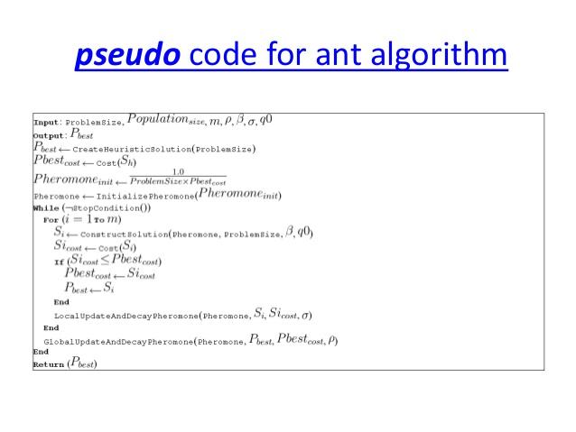
Ant Colony optimization algorithm

Slide 5
Things to know about the ant optimization
The Ant Colony System algorithm was designed for use with combinatorial problems such as the TSP, knapsack problem, quadratic assignment problems, graph coloring problems and many others.
The local pheromone (history) coefficient (sigma) controls the amount of contribution history plays in a components probability of selection and is commonly set to 0.1.
The heuristic coefficient (beta) controls the amount of contribution problem-specific heuristic information plays in a components probability of selection and is commonly between 2 and 5, such as 2.5.
The decay factor (P) controls the rate at which historic information is lost and is commonly set to 0.1.
The greediness factor (Q0) is commonly set to 0.9.
The total number of ants (m) is commonly set low, such as 10

Slide 6
Pre-processing the NN
This increased accuracy rates from 88% to 96%
--- Problem constants
# heuristic; significance of historical choices;
typically between 2 and 5
HEUR = 2.5
# pheromone influence factor
LOCAL_PHERO = 0.1
# likelihood of choosing greedily (instead of probabilistically)
GREED = 0.9

Slide 7

Figure below shows the scope without any pre-processing being done.

Slide 8
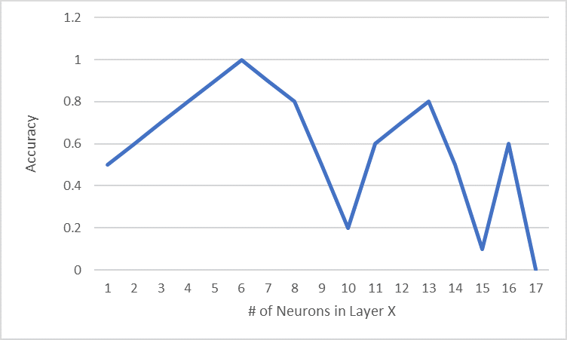
Scope After pre-processing

Slide 9
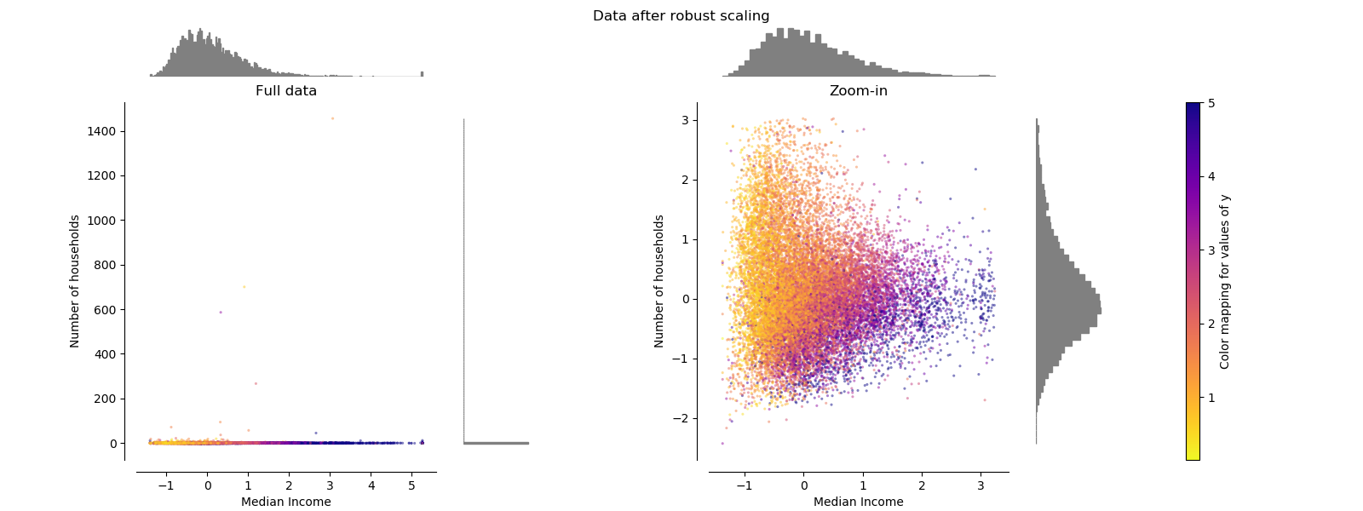
Robust scaler

